Slide 1
Projection
Part One - Parallel Projection
textbook 5.1-5.3

Slide 2
Viewing Types
The two major categories of Projection:
Parallel
Perspective
The default is parallel with a clipping volume
of -1 to 1 on each axis.

Slide 3
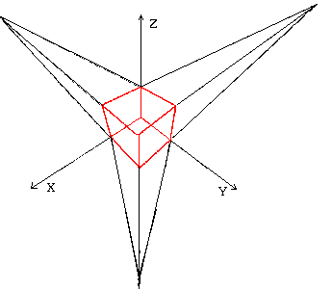
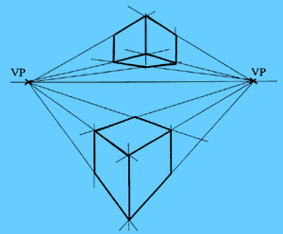
Perspective
www.cs.helsinki.fi
http://www.ider.herts.ac.uk/school/courseware/graphics/images/two_point_perspective.gif

Slide 4
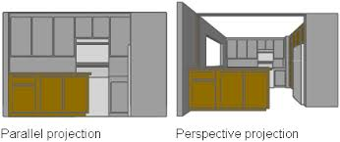
docs.autodesk.com

Slide 5
Which is better?
Q: Which is better, parallel or perspective?
A: Of course, it depends.
Perspective looks more realistic.
Parallel is required for design.
  In parallel, lines are not foreshortened, hence can be used for measuring.

Slide 6
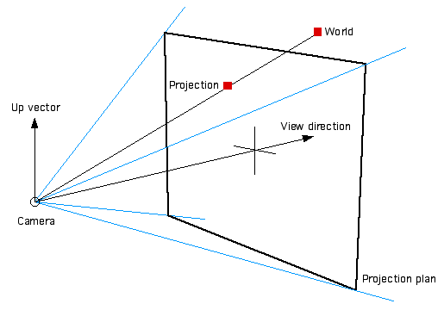
Projection of the World onto the Projection Plane
http://local.wasp.uwa.edu.au/~pbourke/stereographics/HET409_2003/frustum.html

Slide 7
        xp = x
        z / d
(10,?,-20)
-Z
When P = (5, ?, -1)
Xp = 5 / (-1/-1) = 5
(5,?,-10)
When P = (5, ?, -5)
Xp = 5 / (-5/-1) = 1
(5,?,-5)
When P = (10, ?, -20)
Xp = 10 / (-20/-1) = .5
(5,?,-1)
+X
When P = (5, ?, -10)
Xp = 5 / (-10/-1) = .5
+Z
This very simple formula only works
when eye is at the origin.

Slide 8
Viewing Issues
We need the ability to work in units of the application.
We need to position the camera independently of the objects.
We want to be able to specify a clipping volume in units related to the application.
We want to be able to do either parallel or perspective projections.
Angel textbook page 223

Slide 9
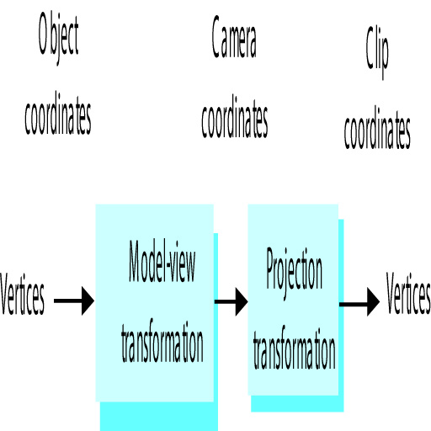
Implementation
Since we do not need to work with the intermediate values, we can combine the model view matrix and the projection matrix.
gl_Position = matrix * vPosition;
Or, leave them separate and have the vertex shader combine them.
gl_Position = projection * modelview * vPosition;
Angel textbook figure 5.11

Slide 10
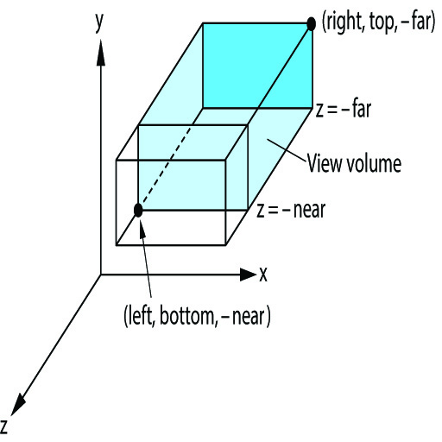
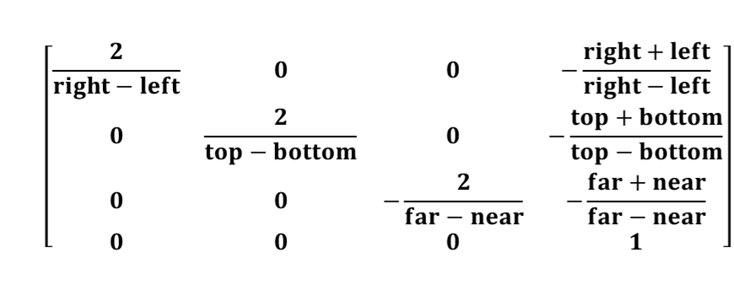
Parallel Projection Matrix
Parallel is a special case of perspective where the eye is infinite distance from the scene.
If we assume the eye is somewhere along the +Z axis then:

Slide 11
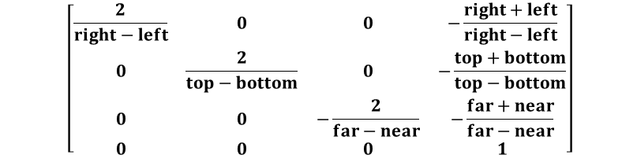
Example 1
Given a world -50 to 50 on each axis,
    left = -50
    right = 50
    top = 50
    bottom = -50
    near = 50
    far = -50
we get the matrix
    ┌ .02 0 0 0 ┐
    │ 0 .02 0 0 │
    │ 0 0 .02 0 │
    └ 0 0 0 1 ┘
P = (25,50,0)
P' = (.5, 1, 0)

Slide 12
Example 2
Given a world -1 to 1 on each axis,
    left = -1
    right = 1
    top = 1
    bottom = -1
    near = 1
    far = -1
we get the matrix
    ┌ 1 0 0 0 ┐
    │ 0 1 0 0 │
    │ 0 0 1 0 │
    └ 0 0 0 1 ┘
So, the default view
yields the identity
projection matrix.

Slide 13
Example 3
Given a world
    left = 0
    right = 2
    top = 2
    bottom = 0
    near = 0
    far = -2
we get the matrix
    ┌ 1 0 0 -1 ┐
    │ 0 1 0 -1 │
    │ 0 0 1 -1 │
    └ 0 0 0 1 ┘
This world is the same size as
the default. To center this world
just move everything to the left
and down.

Slide 14
Building the simple parallel matrix
S = scale ( 2/(right-left), 2/(top-bottom), 2(near-far));
T = translate ( -(right+left)/2, -(top+bottom)/2, (far+near)/2);
ProjMatrix = S * T ;
Angel textbook page 239

Slide 15
Limitations of Simple Parallel
eye must be at infinity on the Z axis.
up is always toward +Y.
We need the ability to work in units of the application.
We need to position the camera independently of the objects.
We want to be able to specify a clipping volume in units related to the application.
We want to be able to do either parallel or perspective projections.

Slide 16
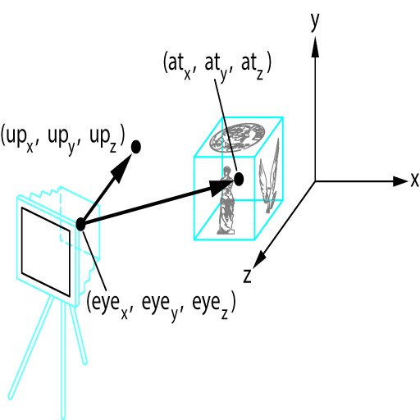
Look At
lookAt (eye, at, up);
eye = X,Y,Z location of eye
at = direction eye is pointed
up = vector to indicate up
note that moving and rotating
the camera is the same as
moving and rotating the world

Slide 17
Implementation
modelView = ortho (left, right, bottom,
top, near, far);
var eye = vec3 (Ex, Ey, Ez);
var at = vec3 (0, 0, 0);
var up = vec3 (0, 1, 0);
projMatrix = lookAt (eye, at, up);
// pass modelView and projMatrix to GPU

Slide 18
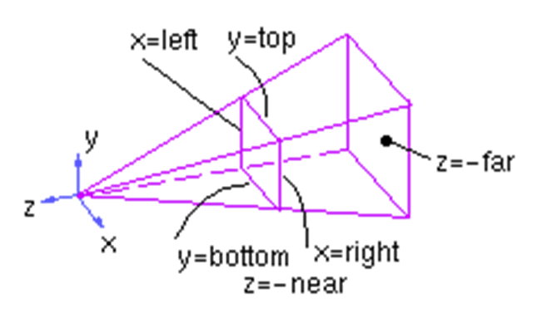

Frustrum Matrix
A = (right+left)/(right-left)
B = (top+bottom)/(top-bottom)
C = -(far+near)/(far-near)
D = -2*far*near/(far-near)
E = 2 * near/(right-left)
F = 2 * near/(top-bottom)

